Slide 1
Boom Bikes Data Analysis

Slide 2
A bike-sharing system is a service in which bikes are made available for shared use to individuals on a short term basis for a price or free. Many bike share systems allow people to borrow a bike from a "dock" which is usually computer-controlled wherein the user enters the payment information, and the system unlocks it. This bike can then be returned to another dock belonging to the same system.
A US bike-sharing provider BoomBikes has recently suffered considerable dips in their revenues due to the ongoing Corona pandemic. The company is finding it very difficult to sustain in the current market scenario. So, it has decided to come up with a mindful business plan to be able to accelerate its revenue as soon as the ongoing lockdown comes to an end, and the economy restores to a healthy state.
In such an attempt, BoomBikes aspires to understand the demand for shared bikes among the people after this ongoing quarantine situation ends across the nation due to Covid-19. They have planned this to prepare themselves to cater to the people's needs once the situation gets better all around and stand out from other service providers and make huge profits.

Slide 3
About the Dataset
The presentation for bikes sharing shows and elaborate the relationship of multiple variables with the count of bikes demanded in both years 2018 and 2019 in US.
The data was cleaned and reluctantly provided in CSV file which is later transformed to the Excel file.
- instant: record index
- dteday : date
- season : season (1:spring, 2:summer, 3:fall, 4:winter)
- yr : year (0: 2018, 1:2019)
- mnth : month ( 1 to 12)
- holiday : weather day is a holiday or not (extracted from http://dchr.dc.gov/page/holiday-schedule)
- weekday : day of the week
- workingday : if day is neither weekend nor holiday is 1, otherwise is 0.

Slide 4
+ weathersit :
- 1: Clear, Few clouds, Partly cloudy, Partly cloudy
- 2: Mist + Cloudy, Mist + Broken clouds, Mist + Few clouds, Mist
- 3: Light Snow, Light Rain + Thunderstorm + Scattered clouds, Light Rain + Scattered clouds
- 4: Heavy Rain + Ice Pallets + Thunderstorm + Mist, Snow + Fog
- temp : temperature in Celsius
- atemp: feeling temperature in Celsius
- hum: humidity
- windspeed: wind speed
- casual: count of casual users
- registered: count of registered users
- cnt: count of total rental bikes including both casual and registered

Slide 5
Year and Season-wise Bikes demanded
Year devisions represent 0:2018, 1:2019
Color representation Blue:2018, Orange: 2019
Seasons representations 1: Spring, 2: Summer
3: Fall, 4: Winter
Conclusion:
The Bikes are mostly demanded in the Fall, Sprint and Winter seasons
And both the year has shown the same level of demand in the provided seasons.

Slide 6
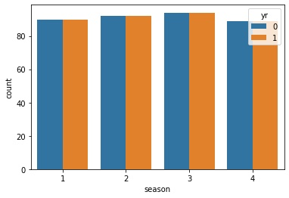
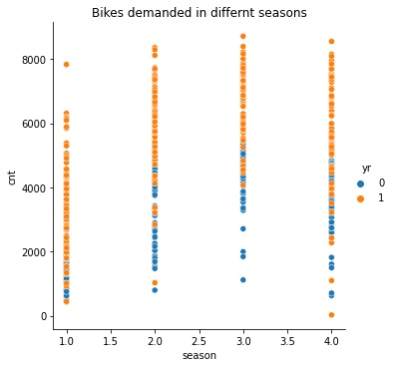

Slide 7
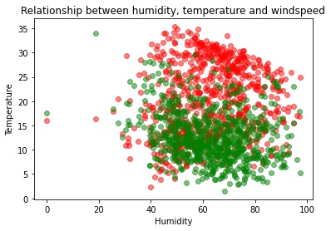
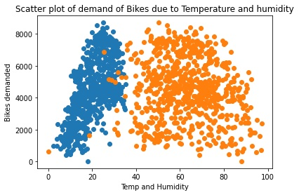
Relationship between Temperature, Humidity and Windspeed

Slide 8
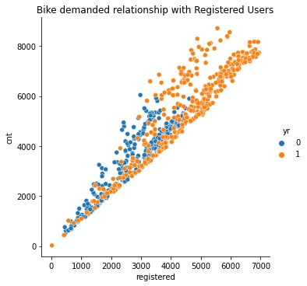
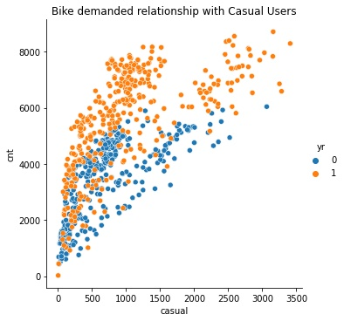
Relationship of Registered and Count users with total Count of Bikes demanded

Slide 9
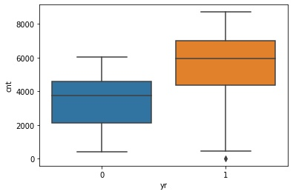
Finding the outlier in year and Count Relationship which is shown in the figure.

Slide 10
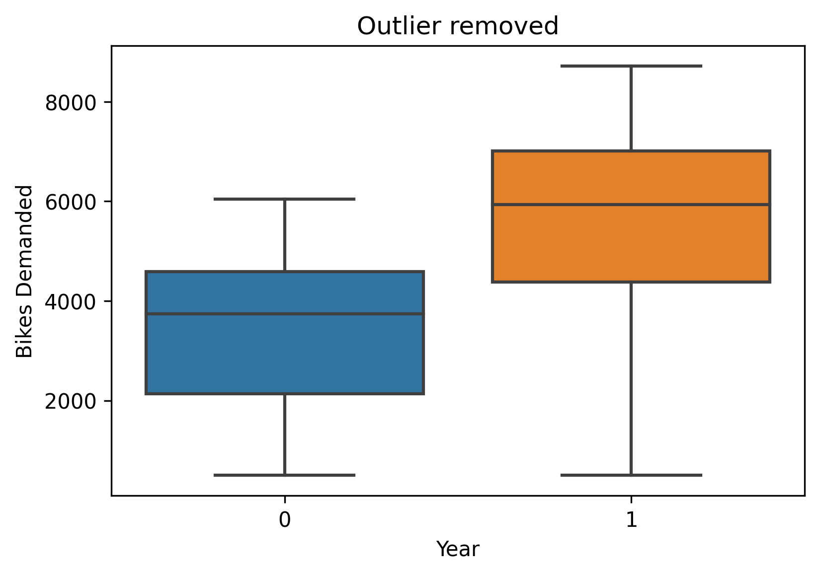
The Outlier was managed by providing the minimum value to all the outlier which has the count of less than 500

Slide 11
Predicted result with R2 score of 0.99, the test result is shown in the Linear Relation with Actual and predicted Demand count of Bikes with less difference in Actual and Predicted values.

Slide 12
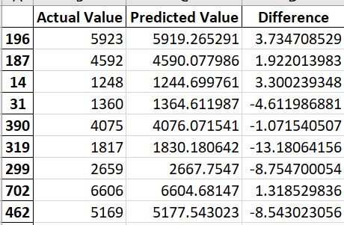

Slide 13
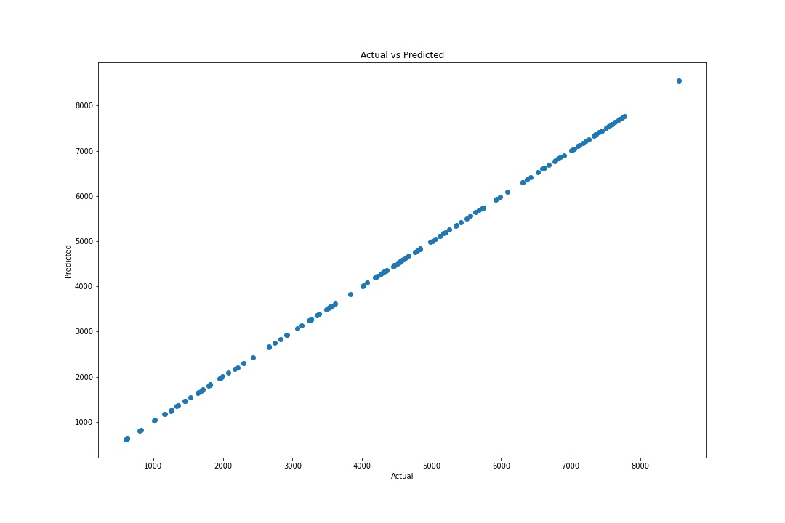

Slide 14
Thank you!

